Slide 1

Journey to your best
Challenge 0 "What's your current version?"
Presentation by Nhat Xuan

Slide 2
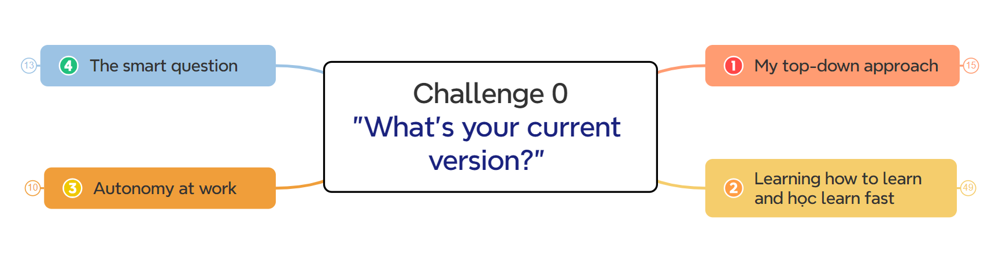
Challenge 0 "What's your current version?"
Mind map | 'What's your current version'

Slide 3
Top-down approach
“is essentially the breaking down of a system to gain insight into its compositional subsystems”

Slide 4
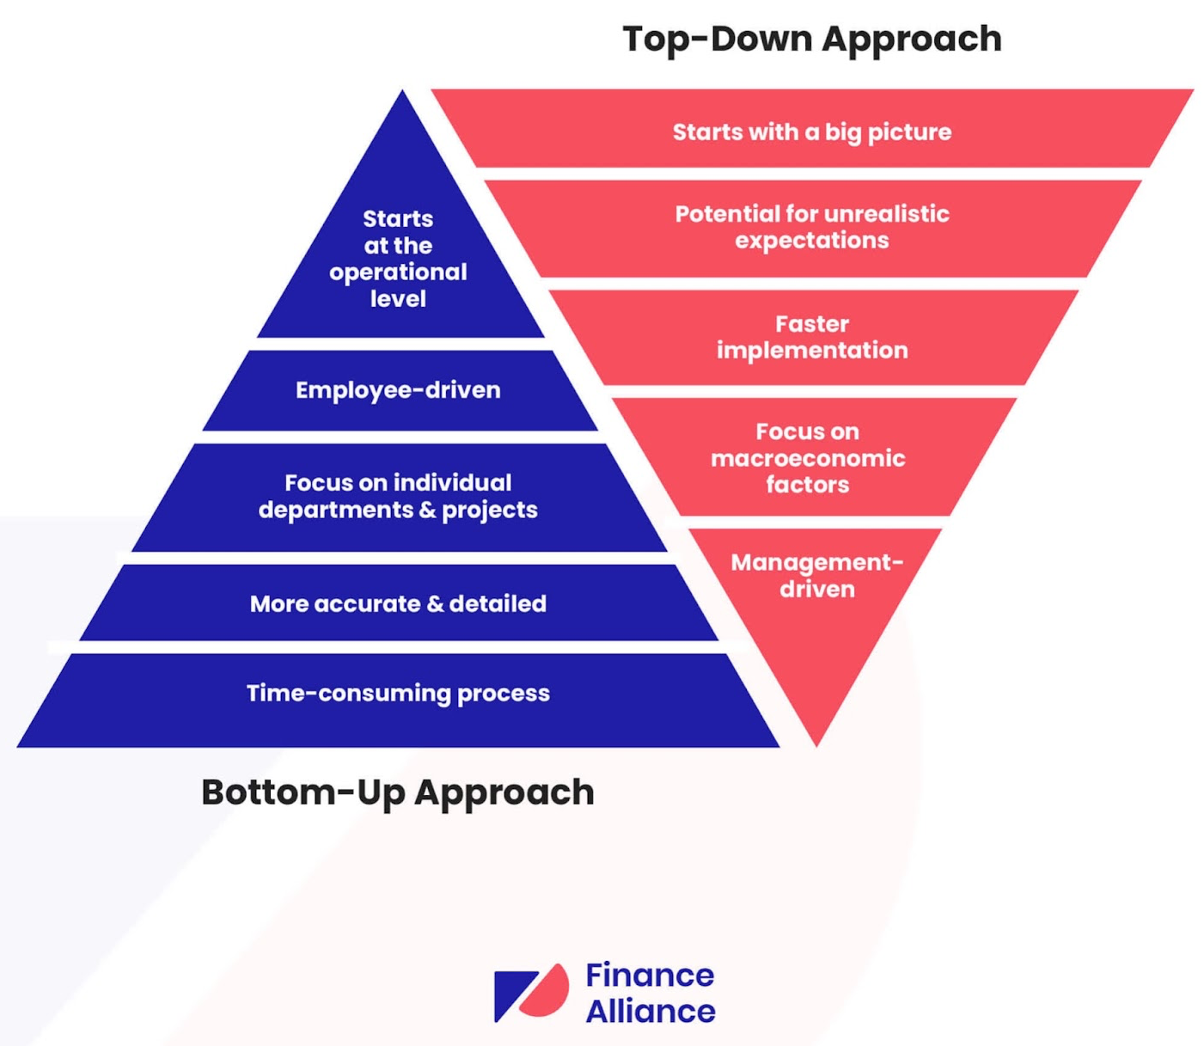
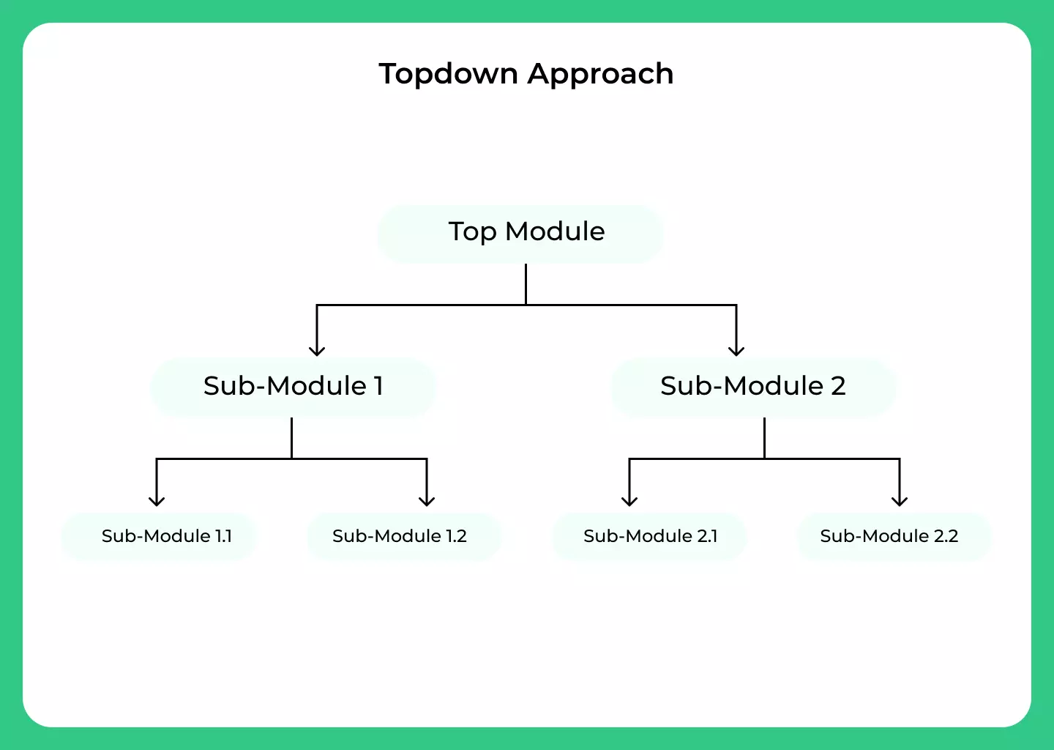

Let's see what people say about the “top-down approach”

Slide 5


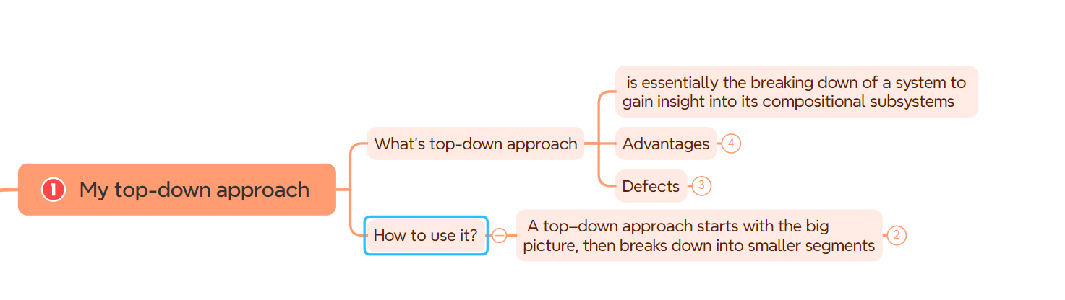
My top-down approach (in work, in a problem, …)
topdown approach
Start with the big picture (from the most basic, most general thing)
Next: Divide the problem into sub-problems, the sub-problems are divided into smaller (more detailed) problems.

Slide 6
Learning how to learn and learn fast
“The content focuses on building strategies and effective learning methods”

Slide 7
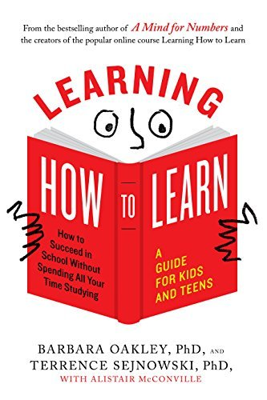
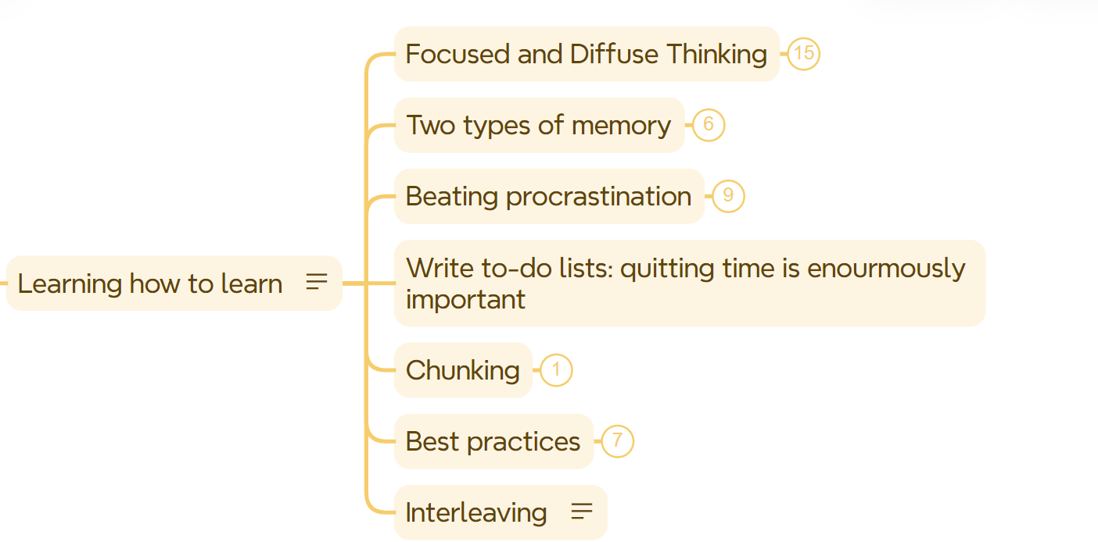
Learning how to learn

Slide 8
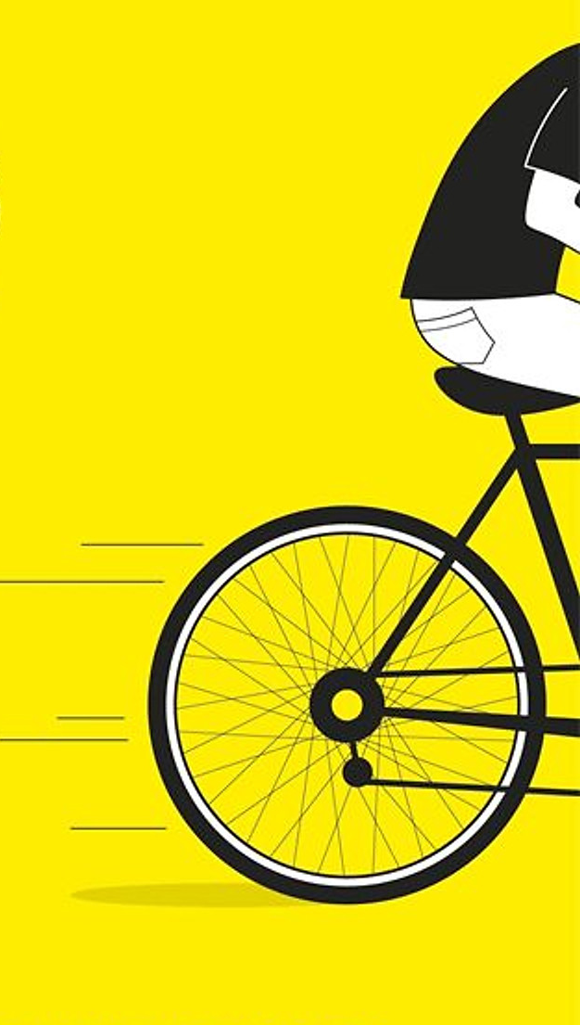
Learn fast
Apply top-down approach
Using some tools to research: Chat GPT, Bing Chat...

Slide 9

Autonomy at work

Slide 10
What's autonomy at work?
Why is it important?
Benefits

Slide 11

What’s the smart question

Slide 12
The smart question
What's the smart question?
Apply it to your work/day
How to ask smart questions
…
..
..

Slide 13
Thank you

